Slide 1
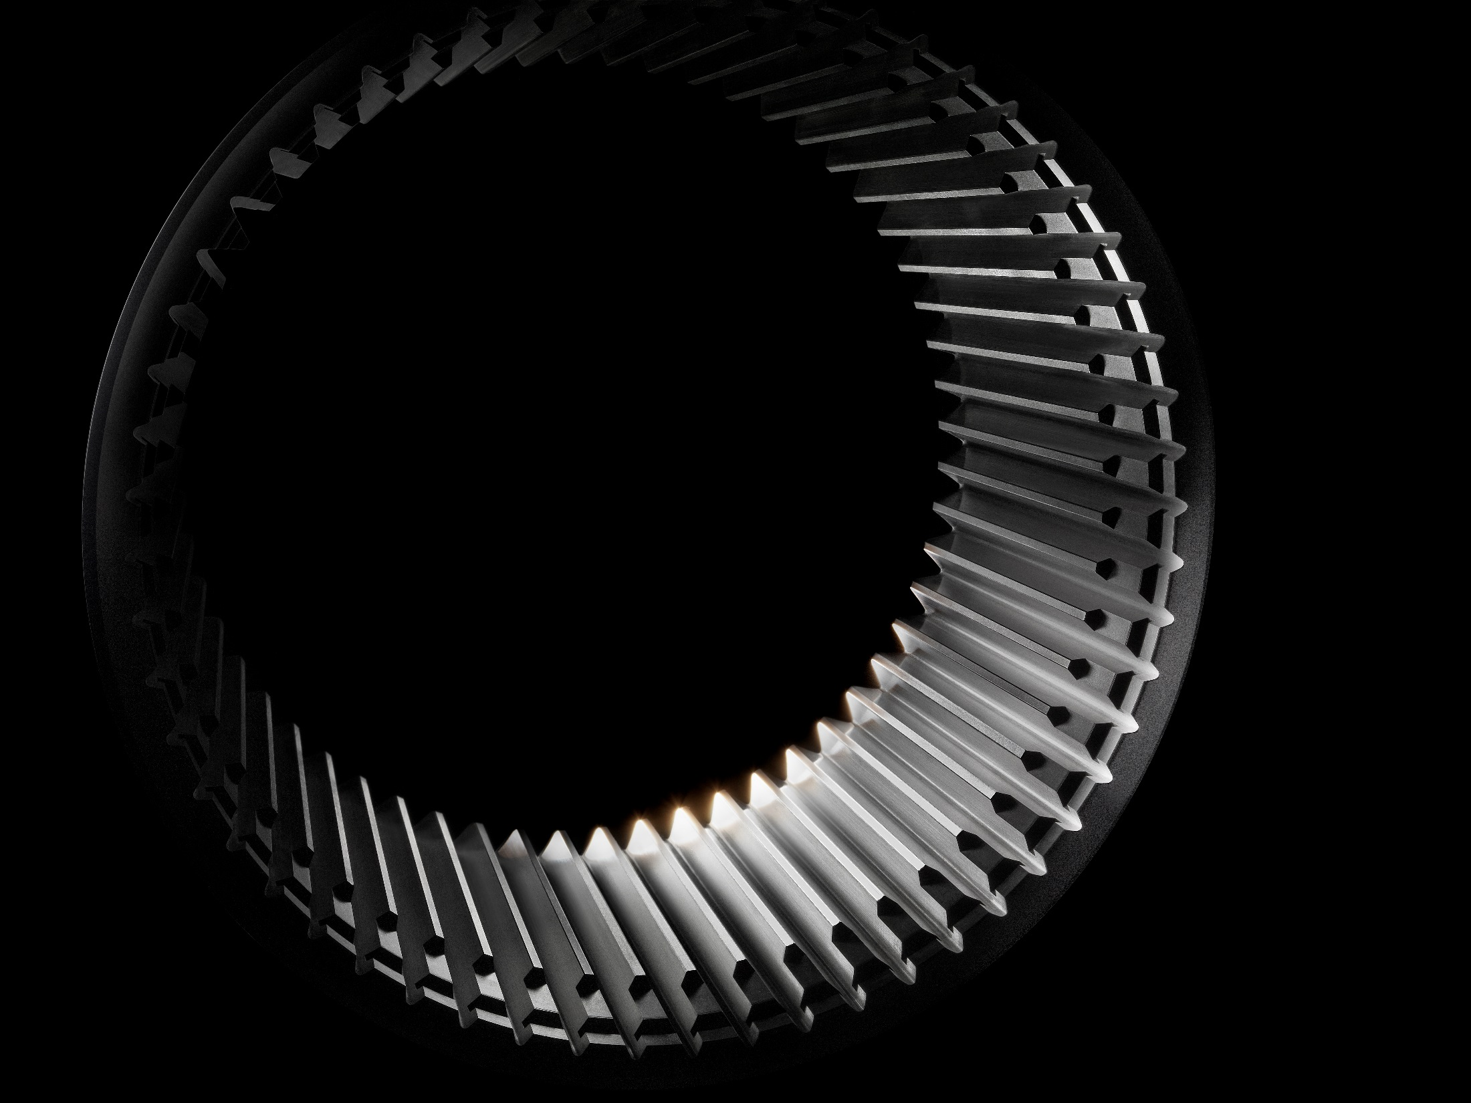





EXCELLENCE PARTNERS FOR MECHANICAL COMPONENTS

Slide 2






OUR NETWORK
9 COMPANIES
800+ EMPLOYEES
200M+ TURNOVER

Slide 3













Cast iron / aluminum machining and assembly
Cast iron / aluminum machining and assembly
Ring gears and toothed components production
Aluminum foundry
New MCR plant
1954
1961
2005
2006
2007
2012
2014
2015
2018
2021
2023
Precision machining of components in steel
Ring gears and toothed components production
Anticorrosive
surface treatments
Project engineering, functional and endurance testing
Aluminum and brass foundry
Rebranding of
our headquarters

Slide 4

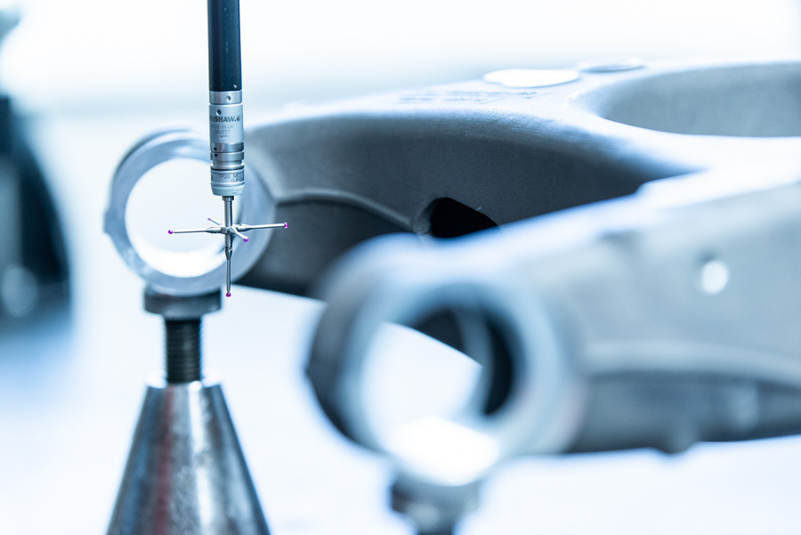
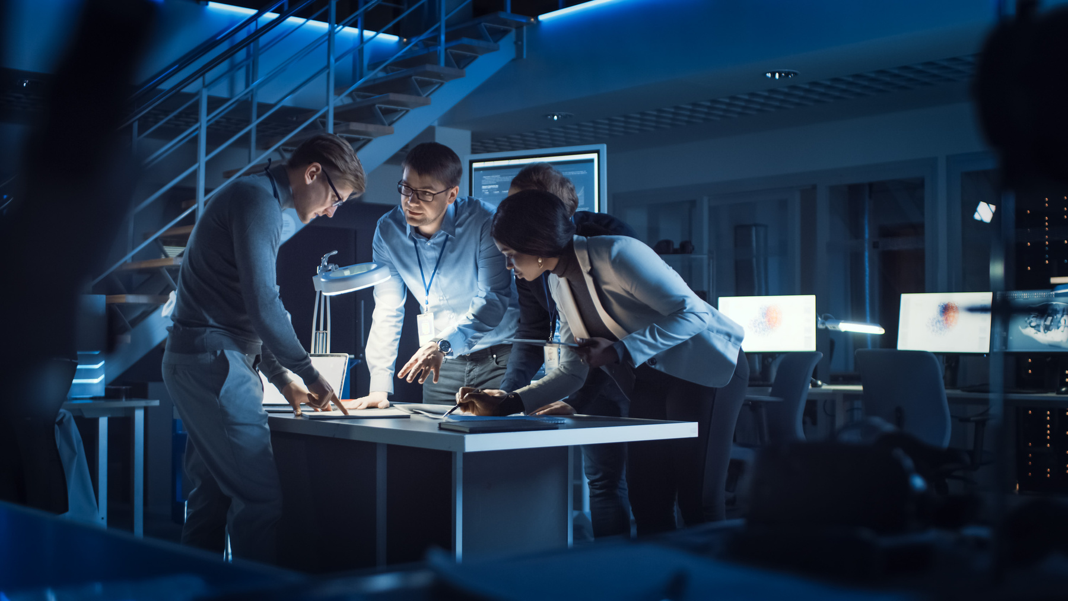

INNOVATION & INDUSTRY 5.0
In this era of rapid change, we’re fully embracing Industry 5.0.
Our focus is on customized production, enhancing human work through tech integration. This approach meets global market challenges effectively.
Our commitment to Industry 5.0 also amplifies our dedication to sustainability, steering us towards a responsible future, with the same attention to innovation, technological progress and the needs of the customers.

Slide 5








THE PILLARS OF OUR NETWORK
CO-DESIGN
The company finds with the customers
the most suitable solutions
VERTICALIZATION
The company disposes of the
technologies to perform all stages
of the production internally
TECH INNOVATION
Specific processes available, several automated cells and state-of-the-art machinery assisted by robots
IMPROVEMENT
Internal teams with several years of experience focused on constant development and process innovation
THERMAL AND SURFACE TREATMENT
The company handles all the final heat treatments and surface treatments to supply the finished product
GLOBAL SUPPLY
Materials sourced globally from
a selection of homologated suppliers
TOP QUALITY
Excellent product competitiveness
PRE-ASSEMBLY & DESIGN
Among our network we are able to supply
Pre-assembled subsets

Slide 6








SUSTAINAIBILITY REPORT
Crafting a comprehensive report aligned with SDGs and GRI international standards, underscoring our environmental and social achievements set for 2024
GREEN ENERGY
Use of energy from 100%
renewable sources
PHOTOVOLTAIC
1615 kW: energy production from
The system across our facilities
CHARGING
Columns for charging electric
vehicles using green energy
ON-SITE ASSEMBLY
Reducing packaging, transportation
and associated emissions
MES SOFTWARE
Thanks to MES and data exchange through electronic devices, we save more than
3 tons of paper yearly
PACKAGING
100% reuse of packaging material
PEOPLE
Work quality policies for
all company employees
COMMUNITY
Support within the territory
and the local community

Slide 7

CAPI GROUP

Slide 8
telephone +39 (0) 464 387578
website www.capigroup.it
email info@capigroup.it
Capi Group is a manufacturing company located in Northern Italy, leader in the production of straight and helical ring gears, toothed components and pre-assembled subsets for several market applications.
It supplies the main OEMs globally.
Depending on technical and qualitative requirements as well as volumes, the gearing is performed internally by different technologies including straight / helical broaching, power skiving. Through co-design with the customers, the most suitable characteristics, process and heat treatments are selected to ensure the best level of competitiveness.
REVENUE (M€)

Slide 9
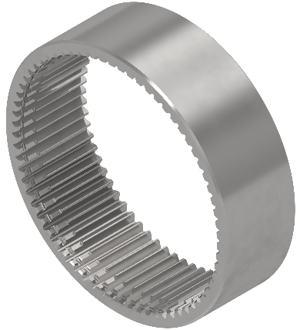
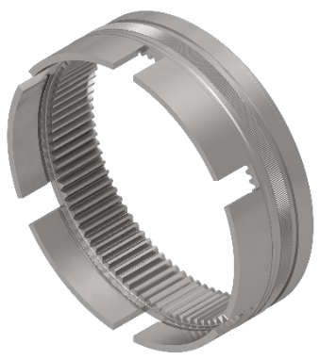
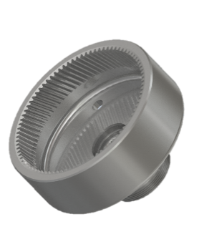
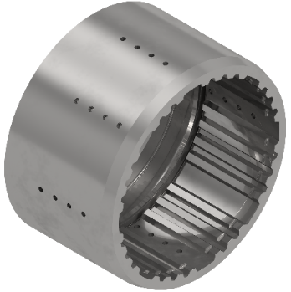
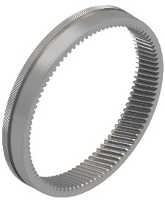
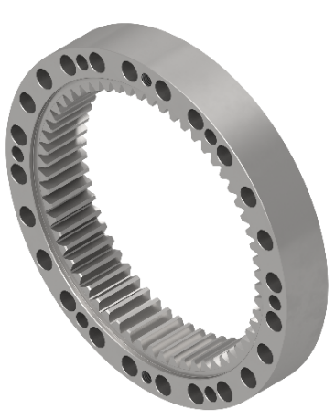
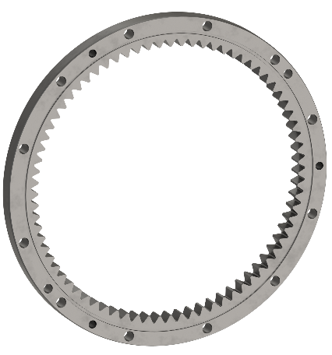
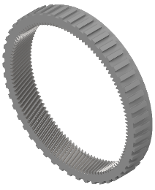
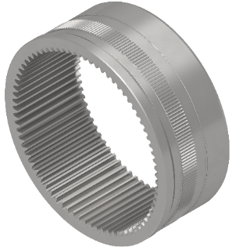
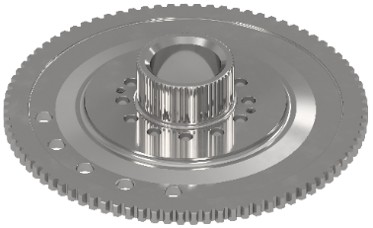
CONSTRUCTION and INDUSTRIAL, MATERIAL HANDLING, AUTOMOTIVE and ELECTRIC DRIVE SYSTEM,
RENEWABLE ENERGY, AGRICULTURAL

Slide 10
AUTOMOTIVE
and ELECTRICAL DRIVELINES
Not only automotive companies but also the major agricultural and construction OEMs, are increasingly focusing on the development of electric drivelines for their leading products.
Capi Group is actively moving in this direction as well and after years of co-design with the customers, it is manufacturing products with this application. Significant technological investments are planned to continue with mass productions.
5
2
3
4
1
1
4
2
5
3

Slide 11
MCA INDUSTRIES

Slide 12

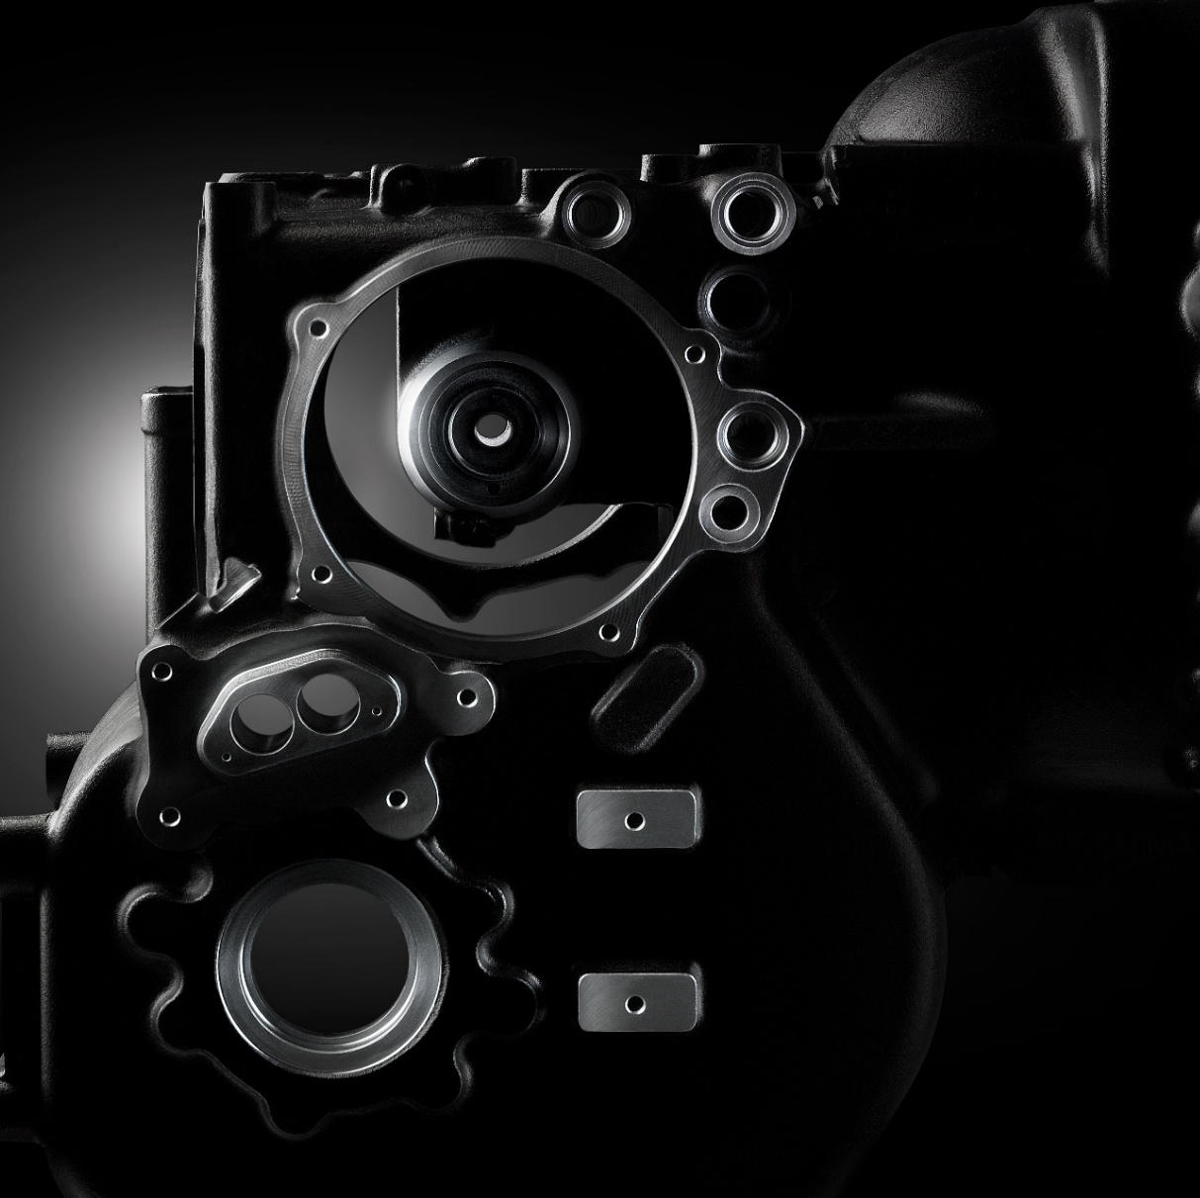
telephone +39 (0) 464 491800
website www.cainelli.com
email info@cainelli.com
MCA Industries is located in Northern Italy; since 1961 it specializes in cast iron and aluminum machining including assembly operations. It has two distinct production plants, the historical building in Volano, hosts machining and assembly of various items such as housings, arms, covers, manifold, frames; the most recent plant in Rovereto is dedicated to specific production families: planetary carriers and knuckles all produced in automatic manufacturing cells.
The long experience, the co-design with the customers, the continuous innovation and lean manufacturing approach applied to the productions make Meccanica Cainelli an ideal partner, ensuring high quality and competitiveness.
REVENUE (M€)

Slide 13
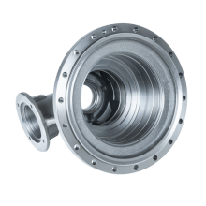
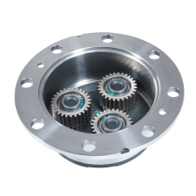
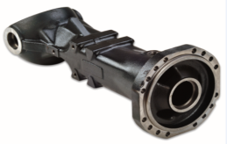
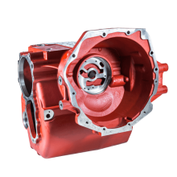
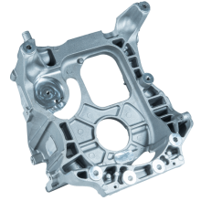
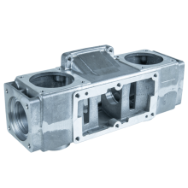
AUTOMOTIVE, AGRICULTURAL, RENEWABLE ENERGY, CONSTRUCTION & INDUSTRIAL, IDRAULIC TRANSMISSIONS
Supplied as single components or in subsets including pre-assembly

Slide 14
OMP INDUSTRIES

Slide 15

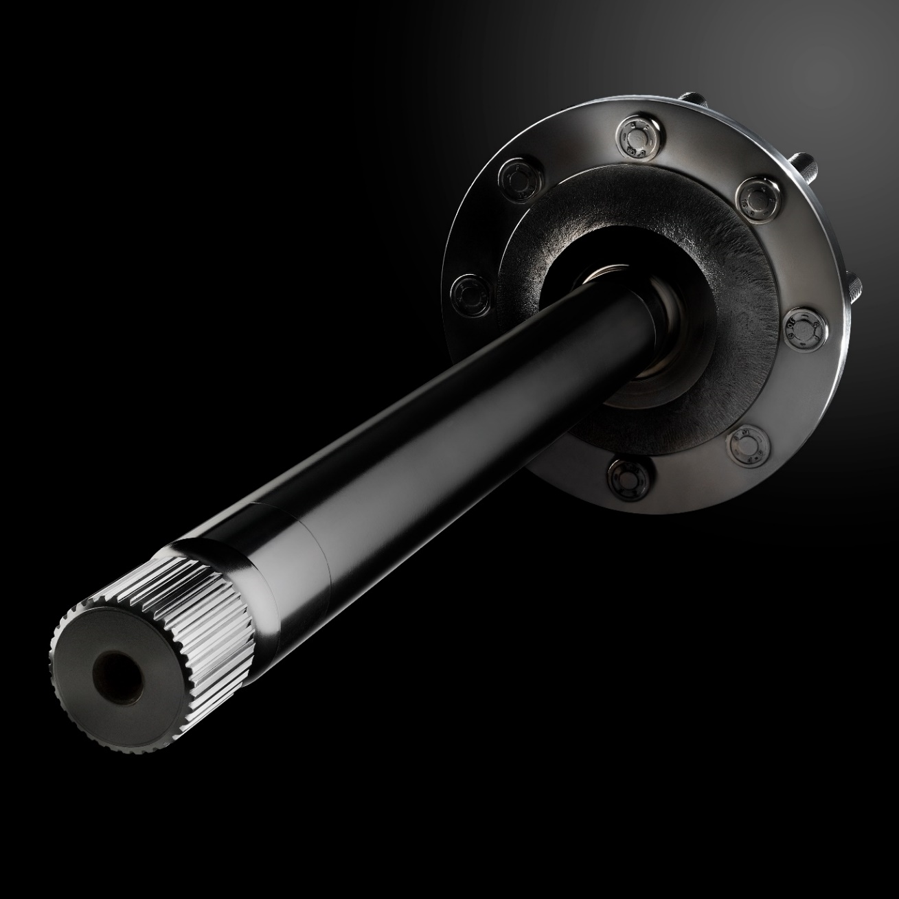
telephone +39 (0) 465 685240
website www.omp-piccinelli.it
email info@omp-piccinelli.it
OMP Industries is a manufacturing company with two production plants located in Northern Italy: in Darzo di Storo and in Calliano.
Thanks to cutting-edge technologies, experience acquired over the years and specific know-how, OMP Piccinelli produces components in steel and supplies as Tier1 to major customers worldwide.
Its production is well diversified supplying the main market segments with: wheel hubs, pins, shafts, steering pins, axle shafts, tapered roller bearing inner and outer rings, distance rings.
REVENUE (M€)

Slide 16
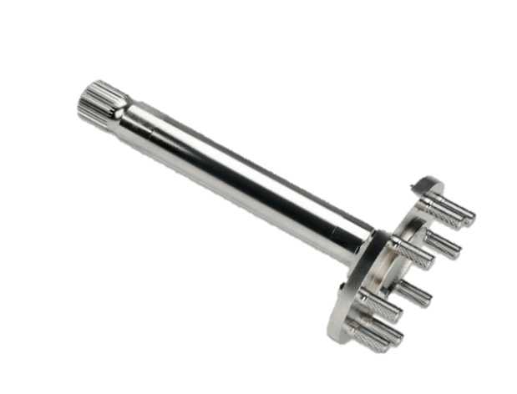
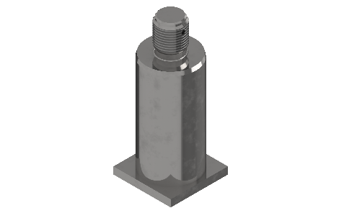
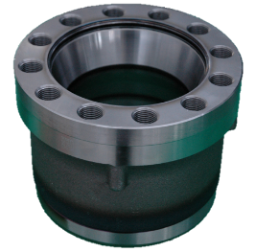
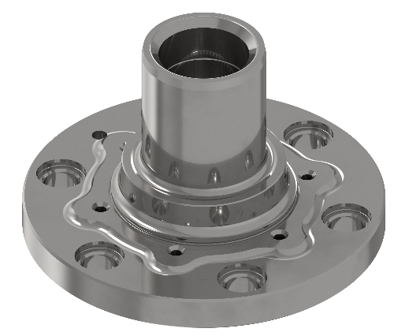
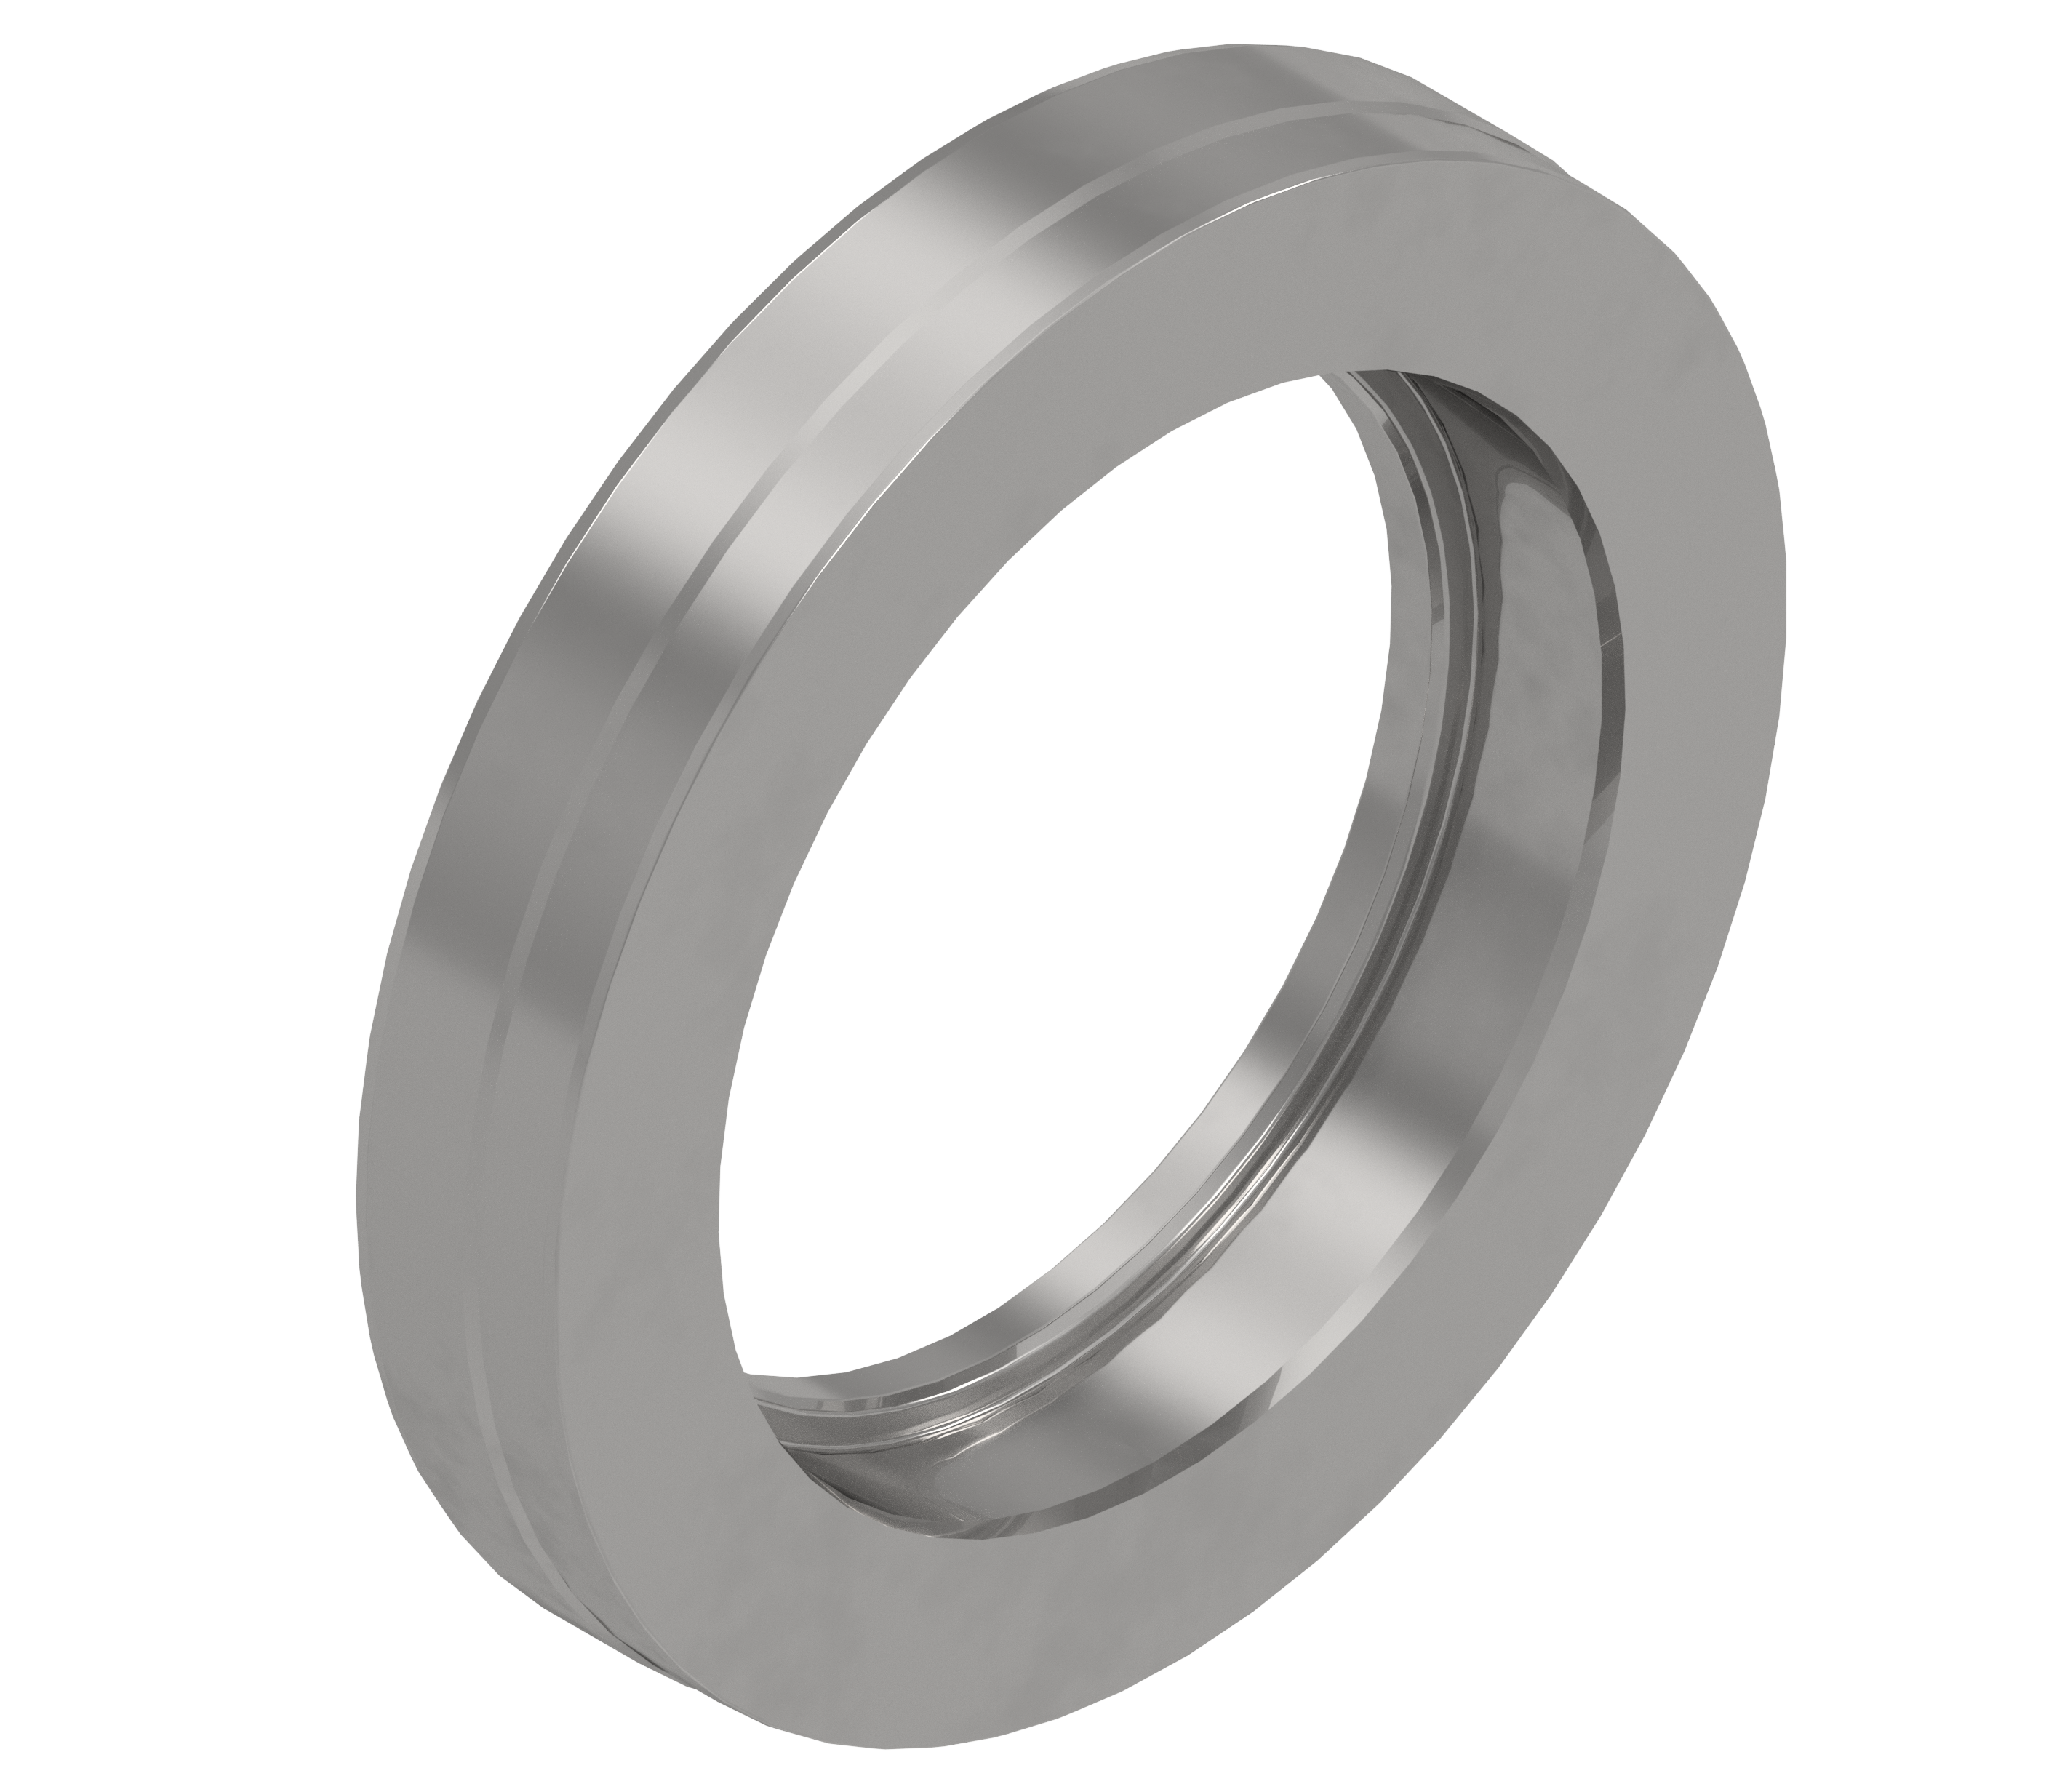
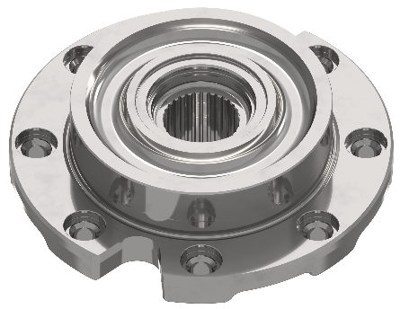
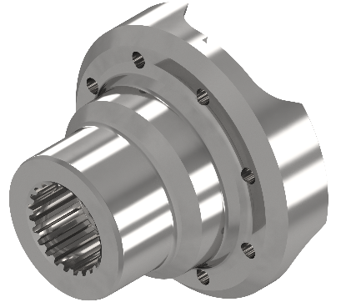
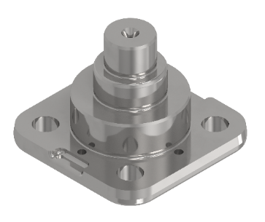
AUTOMOTIVE, AGRICULTURAL, RENEWABLE ENERGY, CONSTRUCTION & INDUSTRIAL

Slide 17
WGT

Slide 18

telephone +39 (0) 464 387578
website www.capigroup.it
email info@capigroup.it
Wuxi Gear Tech is a manufacturing company located in Wuxi (China), it was established in 2012 and it is fully owned by Capi Group. It has state-of-the-art technologies in line with European standards.
WGT is a fully verticalized company specialized in the production of ring gears. It supplies components for axles, transmissions, gearboxes and hub reduction. The ring gears are manufactured in house and the two broaching machines ensure production of items with gearing diameter up to 450mm.
REVENUE (M€)

Slide 19
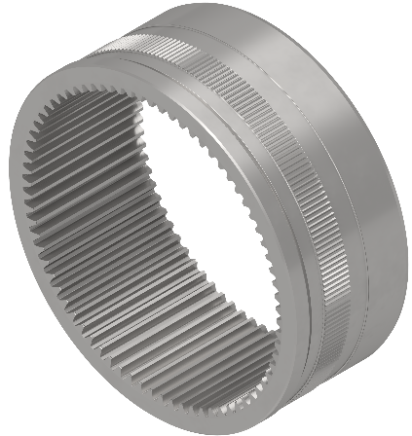
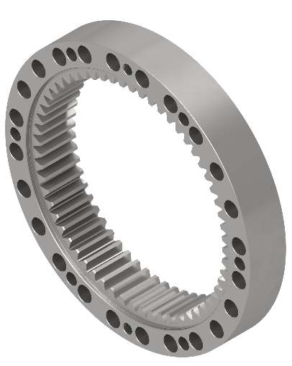
CONSTRUCTION and INDUSTRIAL, RENEWABLE ENERGY, AGRICULTURAL

Slide 20
CPS COMPONENTS

Slide 21
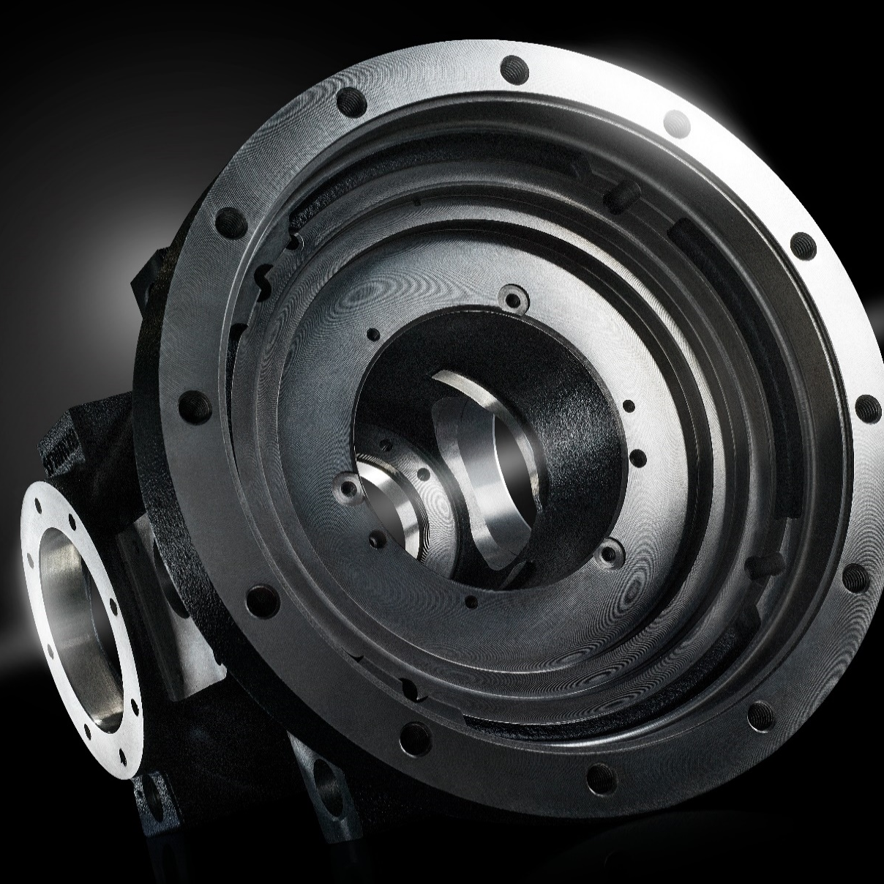
telephone +39 (0) 464 491800
website www.cainelli.com
email info@cainelli.com
CPS Components is a machining company located in Slovakia, it was established in 2006 to supply the North and East European markets. It specializes in cast iron and aluminum machining according to customer design.
The components are used in several markets and fields of application such as Agricultural, Industrial and Construction,
CPS Components ensures advanced productions and it serves closeby OEMs with finished goods.
REVENUE (M€)

Slide 22
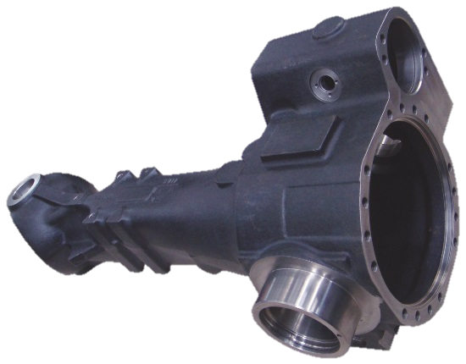
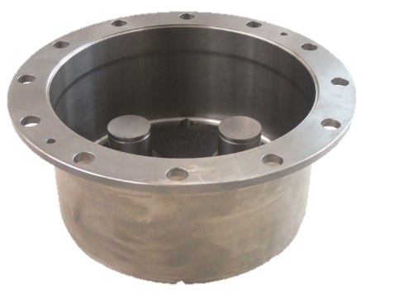
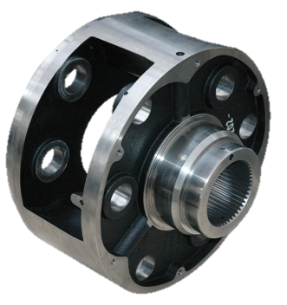
AGRICULTURAL, CONSTRUCTION and INDUSTRIAL

Slide 23
CPT

Slide 24

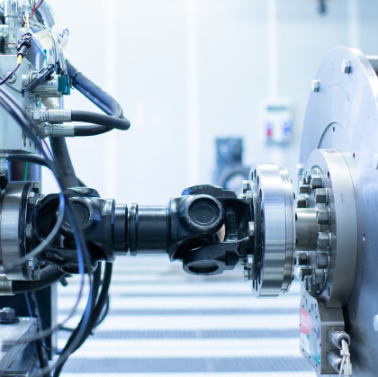
telephone +39 (0) 464 830036
website www.cpt-testingcenter.it
email info@cpt-testingcenter.it
CPT is a service company testing components and groups
for third-parties.
Endurance and functional tests are performed on axles, transmissions and gearboxes of the largest OEMs in the agricultural, industrial and automotive sectors. The testing rooms are complete and can be adapted to different settings, layouts and tests.
REVENUE (M€)

Slide 25

FUNCTIONAL TESTS
DURABILITY TESTS
Checking lubrication / vent leakage
in variable positions
Synchroniser durability
Functional tests of synchronisers:
time, force, deviation
Clutch durability
Course of clutch engagement: engagement time, overlapping of engagement / disengagement curves, thermal stability, sliding torques
Brake durability
Efficiency and thermal stability of brakes
Durability of the entire kinematic chain
Measurement of the contact impression of gears, measurement of vibration / noise
Differential efficiency
Transmission efficiency and thermal stability

Slide 26
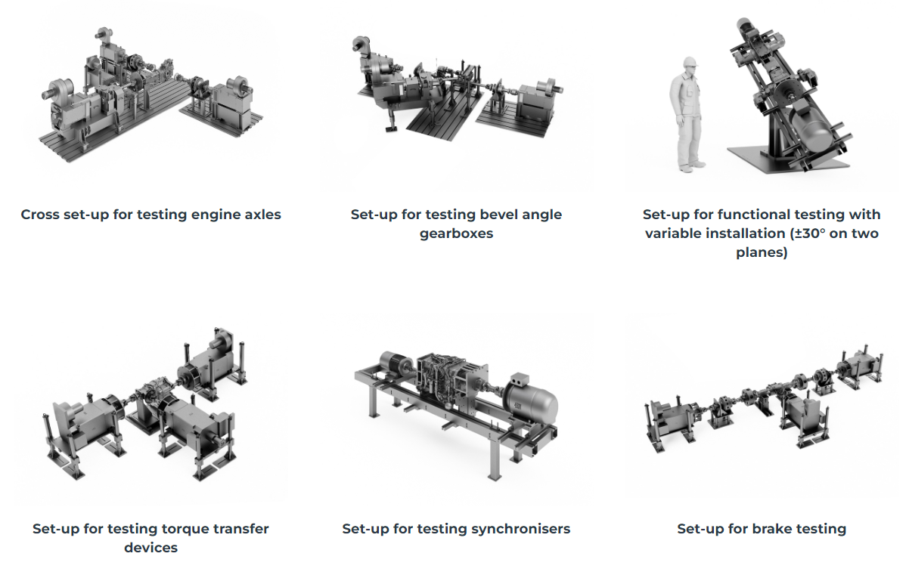

Slide 27
RIVESTCOR

Slide 28

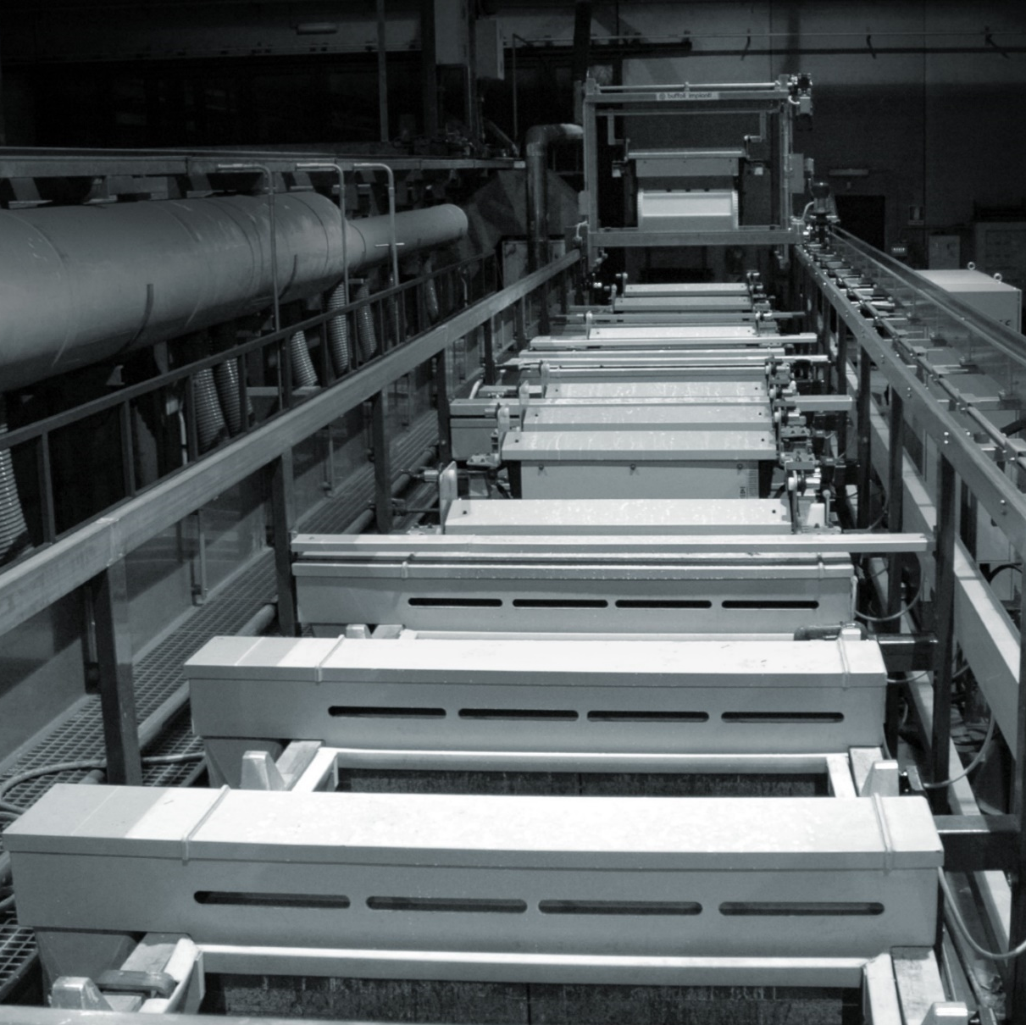
telephone +39 (0) 464 429550
website www.rivestcor.com
email info@rivestcor.com
Rivestcor was established in 2007 in Rovereto, Northern Italy.
It performs anticorrosive surface treatments of electrolytic galvanizing and manganese phosphating with frame and barrel systems.
The purposes of these treatments are to avoid corrosion and reduce maintenance operations on exposed components.
Among the product applications there are: fences and reticular structures, wind towers, ski-lifts, wire ropes and cables, etc.
REVENUE (M€)

Slide 29
NEW OLEF

Slide 30
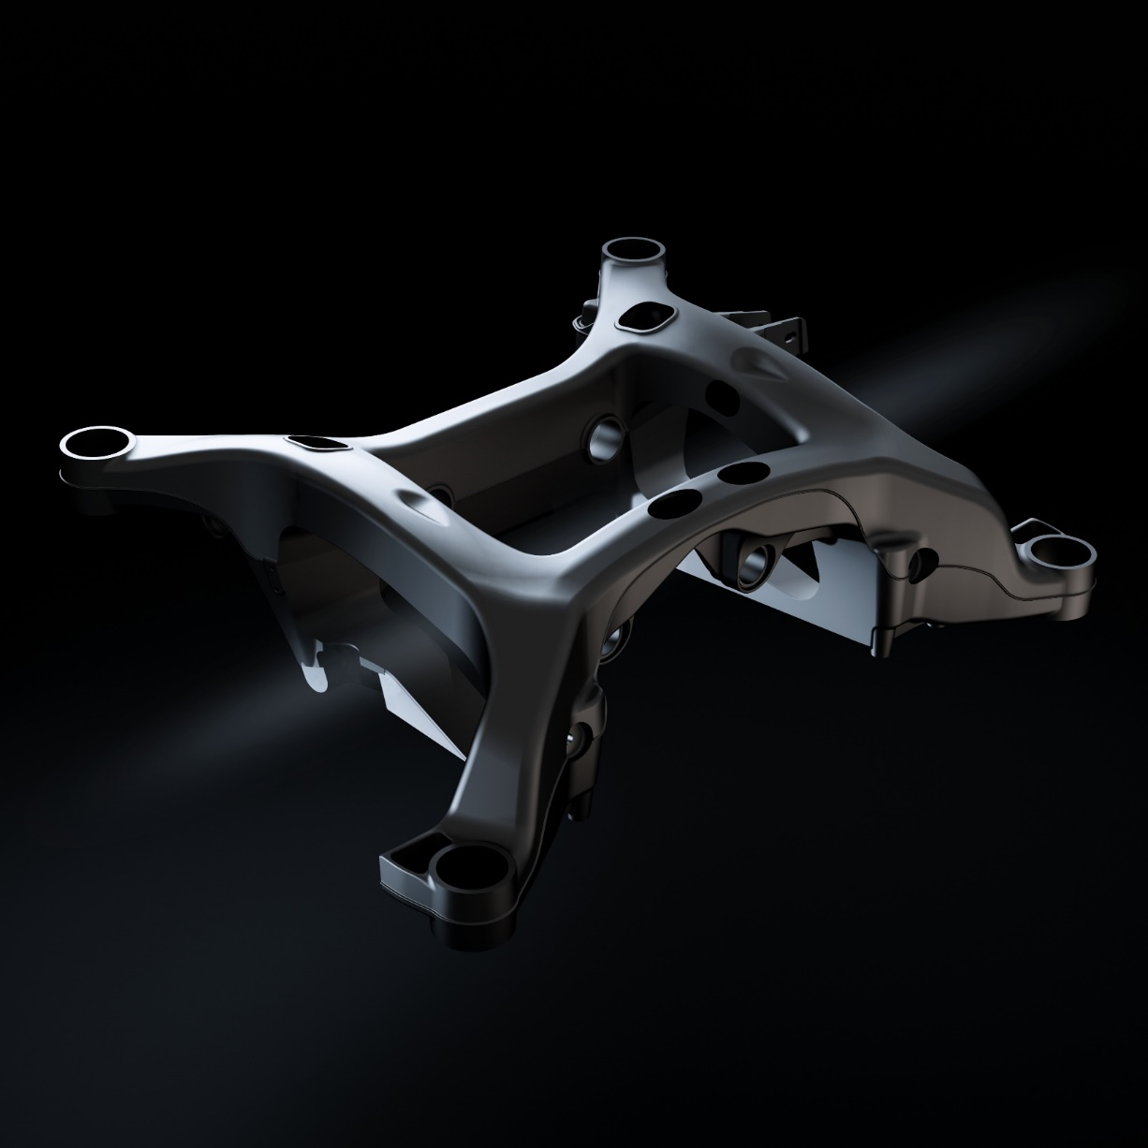
telephone +39 (0) 30 9959572
website www.newolef.com
email info@newolef.it
New Olef is an aluminum foundry located in Brescia, Italy; it was established in 1972 and since 2015 it is part of Capi Group company network. The company produces aluminum components using technologies of gravity and low pressure die casting.
New Olef develops all stages of the production process internally including casting simulation with Magmasoft, mould construction, casting, machining and x-ray/leakage testing, to provide its customers with finished products in a wide dimensional range.
REVENUE (M€)

Slide 31
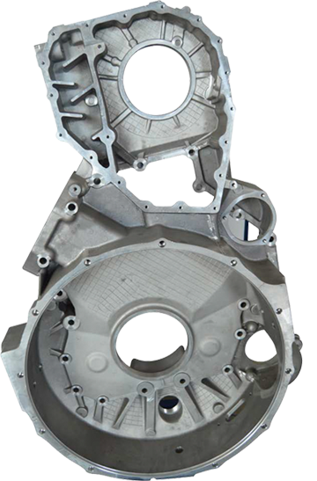
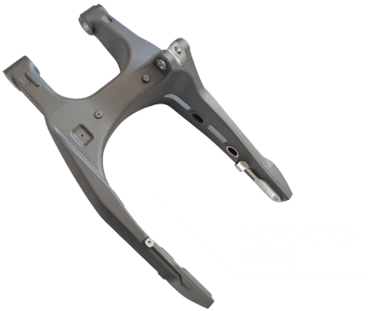
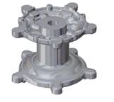
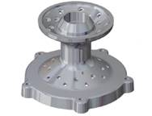
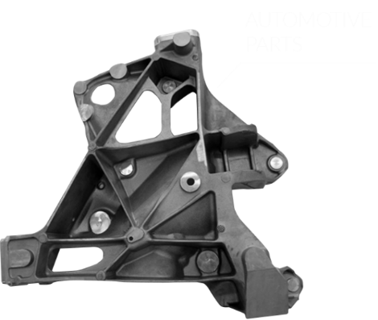
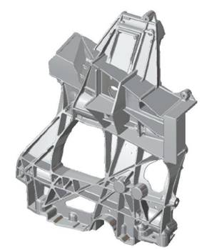
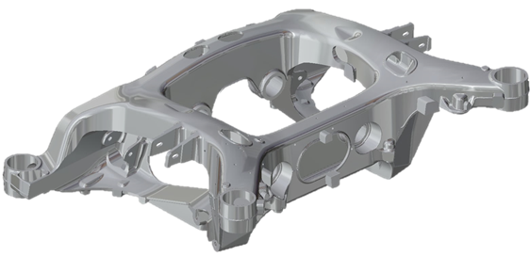
AUTOMOTIVE (BEV, FRAME, ENGINE), AGRICULTURAL, MOTORCYCLE, TRUCK

Slide 32
FISEP

Slide 33

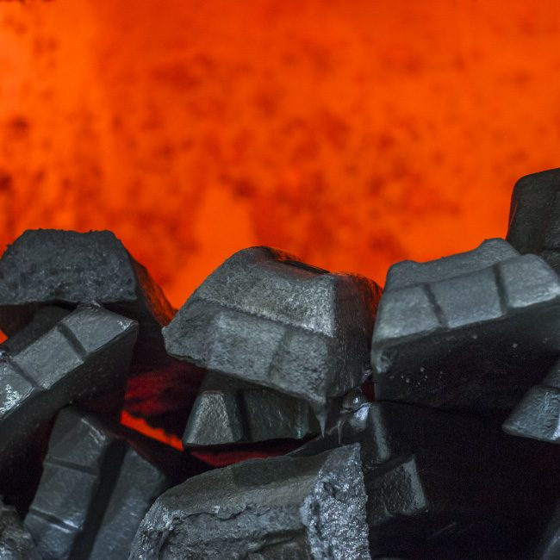
telephone +39 (0) 444 400858
website www.fisep.com
email info@fisep.com
Fisep was founded in 1967, it is a foundry of aluminum and brass located in Vicenza, Italy. Since 2018 it was acquired by New Olef and became part of Capi Group company network.
It specializes in aluminum high pressure die casting and brass hot forging.
Fisep serves several markets with a wide variety of products, its services include all production steps from feasibility studies, HPDS Magma simulation, co-design and mould design, casting and trimming, heat treatment, machining and painting.
REVENUE (M€)

Slide 34
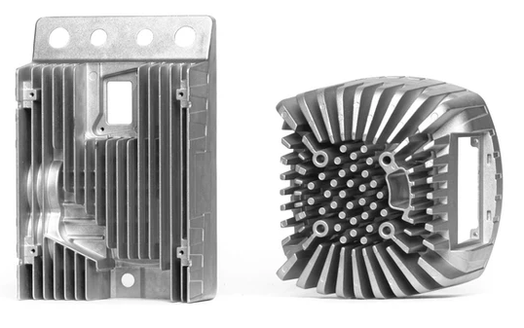
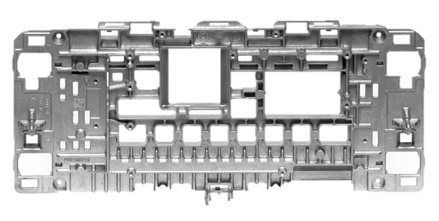
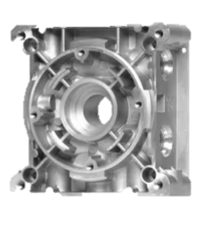








AUTOMOTIVE BEV, HEATING, ENGINE FILTERS, ELECTRICAL ENGINE, CONSTRUCTION EQUIPMENT, HOME APPLICATION, AGRICULTURAL

Slide 35































































JOIN THE ONES WHO TRUST US

Slide 36

COMING TOGETHER IS A BEGINNING
KEEPING TOGETHER IS PROGRESS
WORKING TOGETHER IS SUCCESS
Henry Ford

Slide 37


